Slide 1
Dimensionality Reduction: Principal Component Analysis and SVD
CSN-382

Slide 2




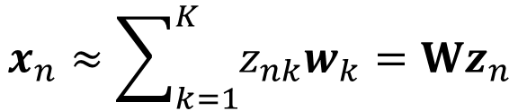
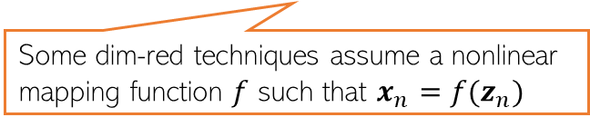
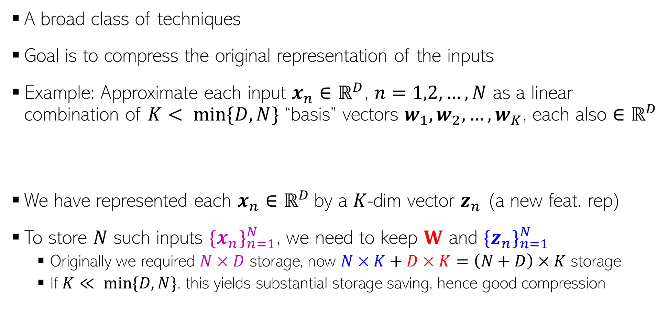

Dimensionality Reduction
Can think of W as a linear mapping that transforms low-dim $z_{n}$ to high-dim $x_{n}$
A broad class of techniques
Goal is to compress the original representation of the inputs
Example: Approximate each input $x_{n}∈ℝ^{D}$, $n=1,2,…,N$ as a linear combination of $K< min\{D,N\}$ “basis” vectors $w_{1},w_{2},…, w_{K}$, each also $∈ℝ^{D}$
We have represented each $x_{n}∈ℝ^{D}$by a $K$-dim vector $z_{n}$ (a new feat. rep)
To store $N$ such inputs ${\{x_{n}\}}_{n=1}^{N}$, we need to keep $W$ and ${\{z_{n}\}}_{n=1}^{N}$
Originally we required $N×D$ storage, now $N×K+D×K=\left(N+D\right)×K$ storage
If $K≪ min⁡\{D,N\}$, this yields substantial storage saving, hence good compression
Some dim-red techniques assume a nonlinear mapping function $f$ such that $x_{n}=f(z_{n})$
For example, $f$ can be modeled by a kernel or a deep neural net
$$x_{n}≈\sum_{k=1}^{K}{z_{nk}w_{k}}=Wz_{n}$$
$W=\left[w_{1},w_{2},…, w_{K}\right]$ is $D×K$
Note: These “basis” vectors need not necessarily be linearly independent. But for some dim. red. techniques, e.g., classic principal component analysis (PCA), they are
$z_{n}=\left[z_{n1},z_{n2},…, z_{nK}\right]$ is $K×1$
Notes:
Basis vectors will come out to be top K eigen vectors in PCA

Slide 3
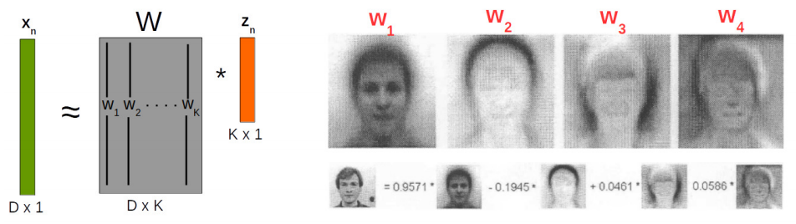


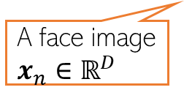







Dimensionality Reduction
Each “basis” image is like a “template” that captures the common properties of face images in the dataset
Dim-red for face images
In this example, $z_{n}∈ℝ^{K} (K=4)$ is a low-dim feature rep. for $x_{n}∈ℝ^{D}$
Essentially, each face image in the dataset now represented by just 4 real numbers ☺
Different dim-red algos differ in terms of how the basis vectors are defined/learned
.. And in general, how the function $f$ in the mapping $x_{n}= f(z_{n})$is defined
K=4 “basis” face images
+
A face image $x_{n}∈ℝ^{D}$
$$z_{n1}$$
$$z_{n2}$$
$$z_{n3}$$
$$z_{n4}$$
$$w_{4}$$
$$w_{1}$$
$$w_{2}$$
$$w_{3}$$
Like 4 new features

Slide 4
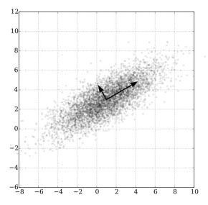

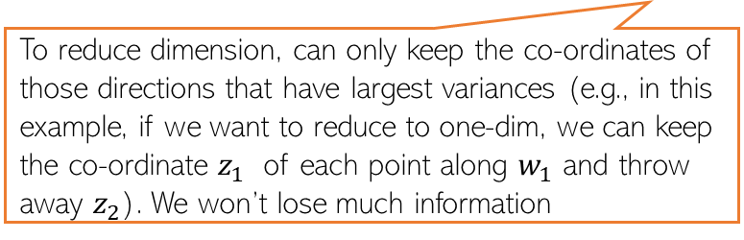



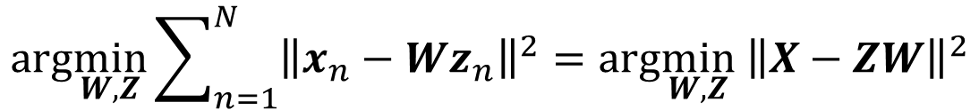


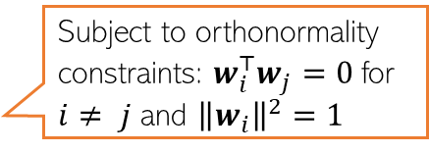
Principal Component Analysis (PCA)
A classic linear dim. reduction method (Pearson, 1901; Hotelling, 1930)
Can be seen as
Learning directions (co-ordinate axes) that capture maximum variance in data
Learning projection directions that result in smallest reconstruction error
PCA also assumes that the projection directions are orthonormal
$$e_{2}$$
PCA is essentially doing a change of axes in which we are representing the data
$e_{1},e_{2}:$ Standard co-ordinate axis ($x=[x_{1},x_{2}]$)
$$w_{1}$$
$$w_{2}$$
$w_{1},w_{2}:$ New co-ordinate axis ($z=[z_{1},z_{2}]$)
Small variance
Each input will still have 2 co-ordinates, in the new co-ordinate system, equal to the distances measured from the new origin
To reduce dimension, can only keep the co-ordinates of those directions that have largest variances (e.g., in this example, if we want to reduce to one-dim, we can keep the co-ordinate $z_{1}$ of each point along $w_{1}$ and throw away $z_{2}$). We won’t lose much information
Large variance
$$e_{1}$$
Subject to orthonormality constraints: $w_{i}^{⊤}w_{j}=0$for $i≠ j$ and ${\left\|w_{i}\right\|}^{2}=1$
$$arg\min_{W,Z}\sum_{n=1}^{N}{{\left\|x_{n}−Wz_{n}\right\|}^{2}=arg\min_{W,Z}{ \left\|X−ZW\right\|}^{2}}$$

Slide 5
PCA: From the variance perspective

Slide 6


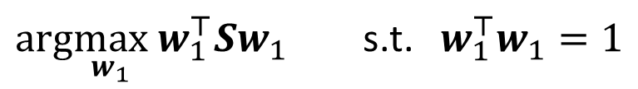



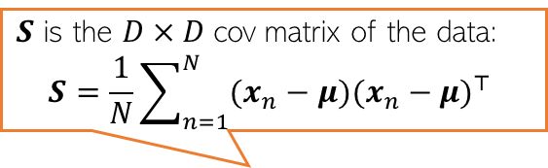

Solving PCA by Finding Max. Variance Directions
Consider projecting an input $x_{n}∈ℝ^{D}$along a direction $w_{1}$ $∈ℝ^{D}$
Projection/embedding of $x_{n}$ (red points below) will be $w_{1}^{⊤}x_{n}$ (green pts below)
Want $w_{1}$ such that variance $w_{1}^{⊤}Sw_{1}$ is maximized
Mean of projections of all inputs:
$\frac{1}{N}\sum_{n=1}^{N}{w_{1}^{⊤}x_{n}= }$ $w_{1}^{⊤}(\frac{1}{N}\sum_{n=1}^{N}{x_{n})=w_{1}^{⊤}μ}$
Variance of the projections:
$$\frac{1}{N}\sum_{n=1}^{N}{{{(w}_{1}^{⊤}x_{n}−w_{1}^{⊤}μ)}^{2}=\frac{1}{N}\sum_{n=1}^{N}{{{\{w}_{1}^{⊤}{(x}_{n}−μ)\}}^{2}=}}w_{1}^{⊤}Sw_{1}$$
$$w_{1}$$
$$x_{n}$$
$S$ is the $D×D$cov matrix of the data:
$$S=\frac{1}{N}\sum_{n=1}^{N}{(x_{n}−μ){(x_{n}−μ)}^{⊤} }$$
$$w_{1}^{⊤}x_{n}$$
For already centered data, $μ$= $0$ and $S=\frac{1}{N}\sum_{n=1}^{N}{x_{n}}x_{n}^{⊤}$ = $\frac{1}{N}X^{⊤}X$
$arg\max_{w_{1}}$ $w_{1}^{⊤}Sw_{1}$ s.t. $w_{1}^{⊤}w_{1}=1$
Need this constraint otherwise the objective’s max will be infinity

Slide 7


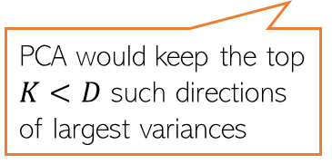
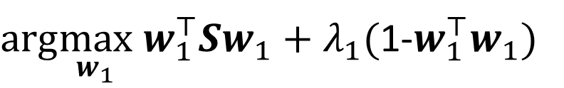
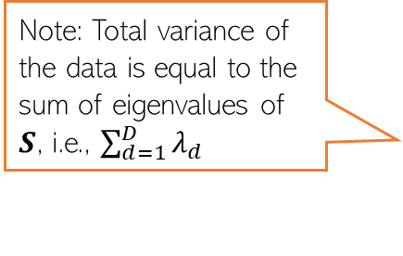
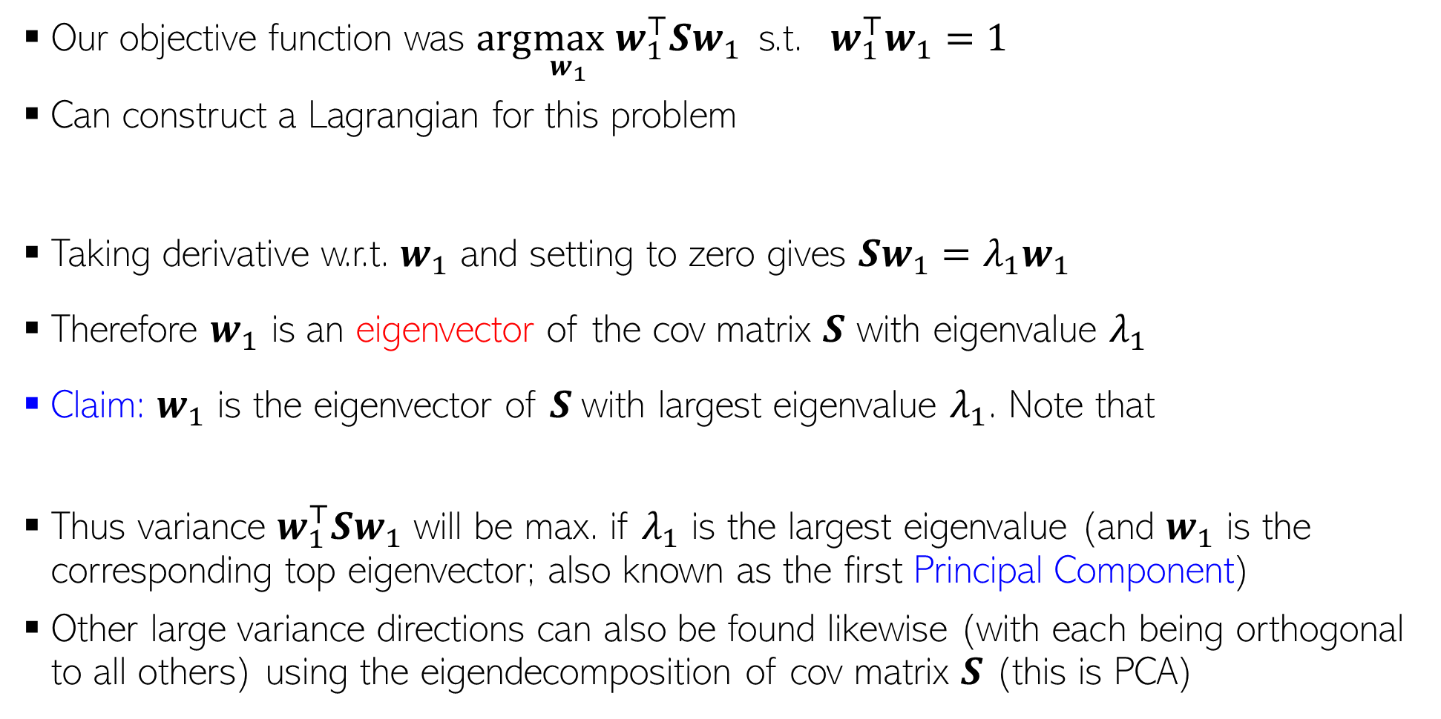

Max. Variance Direction
Variance along the direction $w_{1}$
Note: Total variance of the data is equal to the sum of eigenvalues of $S$, i.e., $\sum_{d=1}^{D}{λ_{d}}$
Our objective function was $arg\max_{w_{1}}$ $w_{1}^{⊤}Sw_{1}$ s.t. $w_{1}^{⊤}w_{1}=1$
Can construct a Lagrangian for this problem
Taking derivative w.r.t. $w_{1}$ and setting to zero gives $Sw_{1}=λ_{1}w_{1}$
Therefore $w_{1}$ is an eigenvector of the cov matrix $S$ with eigenvalue $λ_{1}$
Claim: $w_{1}$ is the eigenvector of $S$with largest eigenvalue $λ_{1}$. Note that
Thus variance $w_{1}^{⊤}Sw_{1}$ will be max. if $λ_{1}$ is the largest eigenvalue (and $w_{1}$ is the corresponding top eigenvector; also known as the first Principal Component)
Other large variance directions can also be found likewise (with each being orthogonal to all others) using the eigendecomposition of cov matrix $S$ (this is PCA)
PCA would keep the top $K<D$ such directions of largest variances
$arg\max_{w_{1}} w_{1}^{⊤}Sw_{1}+λ_{1}($1-$w_{1}^{⊤}w_{1})$
Note: In general, $S$ will have $D$ eigvecs
$w_{1}^{⊤}Sw_{1}=λ_{1}w_{1}^{⊤}w_{1}=λ_{1}$

Slide 8
PCA: From the reconstruction perspective

Slide 9
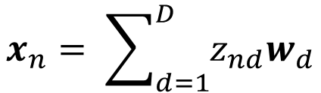
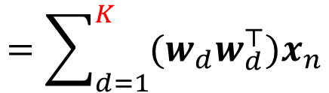
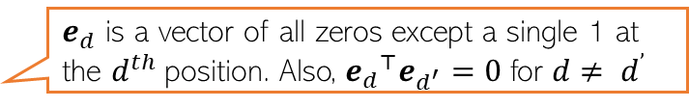


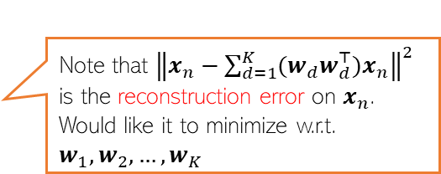
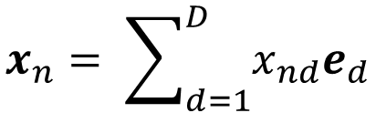
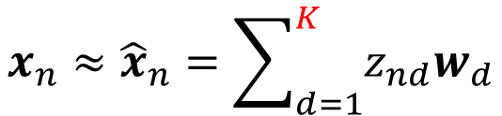


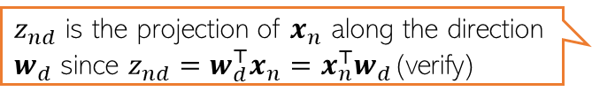
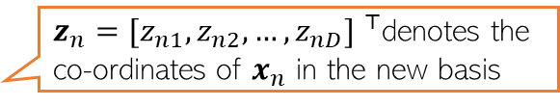

Alternate Basis and Reconstruction
Representing a data point $x_{n}= {[x_{n1},x_{n2},…, x_{nD}] }^{⊤}$ in the standard orthonormal basis $\left\{e_{1},e_{2},…, e_{D}\right\}$
Let’s represent the same data point in a new orthonormal basis $\left\{w_{1},w_{2},…, w_{D}\right\}$
Ignoring directions along which projection $z_{nd}$ is small, we can approximate $x_{n}$ as
Now $x_{n}$ is represented by $K < D$dim. rep. $z_{n} =[z_{n1},z_{n2},…, z_{nK}]$ and (verify)
$$x_{n}= \sum_{d=1}^{D}{x_{nd}e_{d}}$$
$e_{d}$ is a vector of all zeros except a single 1 at the $d^{th}$position. Also, ${e_{d}}^{⊤}e_{d^{′}}=0$ for $d≠ d^{’}$
$z_{nd}$ is the projection of $x_{n}$ along the direction $w_{d}$ since $z_{nd}=w_{d}^{⊤}x_{n}=x_{n}^{⊤}w_{d}$(verify)
$$x_{n}= \sum_{d=1}^{D}{z_{nd}w_{d}}$$
$z_{n}={[z_{n1},z_{n2},…, z_{nD}] }^{⊤}$denotes the co-ordinates of $x_{n}$ in the new basis
$$x_{n}≈{\hat{x}}_{n}=\sum_{d=1}^{K}{z_{nd}w_{d}}$$
$$=\sum_{d=1}^{K}{{(x}_{n}^{⊤}w_{d})w_{d}}$$
$$=\sum_{d=1}^{K}{{(w_{d}w}_{d}^{⊤})x_{n}}$$
Note that ${\left\|x_{n}−\sum_{d=1}^{K}{{(w_{d}w}_{d}^{⊤})x_{n}}\right\|}^{2}$ is the reconstruction error on $x_{n}$. Would like it to minimize w.r.t. $w_{1},w_{2},…, w_{K}$
$$z_{n}≈ W_{K}^{⊤}x_{n}$$
$W_{K}=\left[w_{1},w_{2},…, w_{K}\right]$ is the “projection matrix” of size $D×K$
Also, $x_{n}≈W_{K}z_{n}$

Slide 10

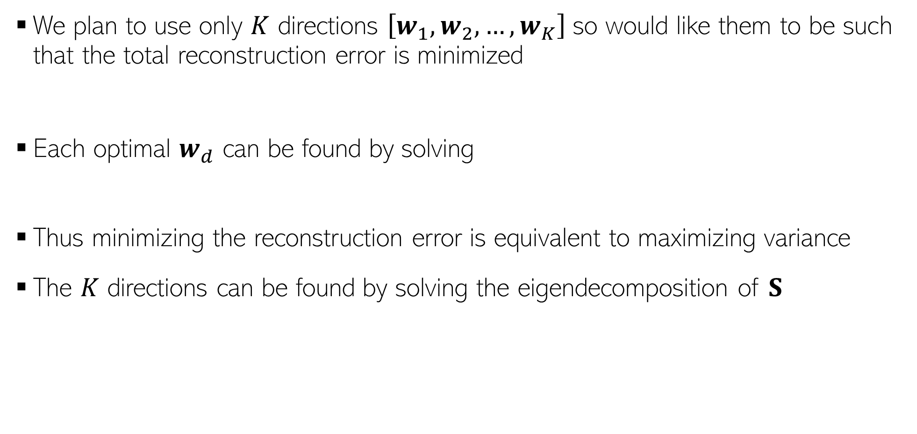
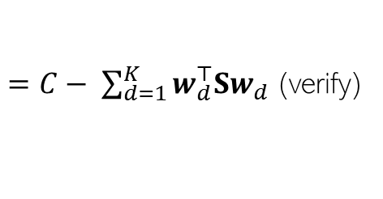


Minimizing Reconstruction Error
We plan to use only $K$ directions $\left[w_{1},w_{2},…, w_{K}\right]$so would like them to be such that the total reconstruction error is minimized
Each optimal $w_{d}$ can be found by solving
Thus minimizing the reconstruction error is equivalent to maximizing variance
The $K$ directions can be found by solving the eigendecomposition of $S$
Constant; doesn’t depend on the $w_{d}$’s
$$ℒ\left(w_{1},w_{2},…, w_{K}\right)= \sum_{n=1}^{N}{{\left\|x_{n}−{\hat{x}}_{n}\right\|}^{2}=\sum_{n=1}^{N}{{\left\|x_{n}−\sum_{d=1}^{K}{{(w_{d}w}_{d}^{⊤})x_{n}}\right\|}^{2}}}$$
$=C− \sum_{d=1}^{K}{w_{d}^{⊤}Sw_{d}}$ (verify)
Variance along $w_{d}$
$arg\min_{w_{d}}$ $ℒ\left(w_{1},w_{2},…, w_{K}\right)=arg\max_{w_{d}} { w}_{d}^{⊤}Sw_{d}$

Slide 11



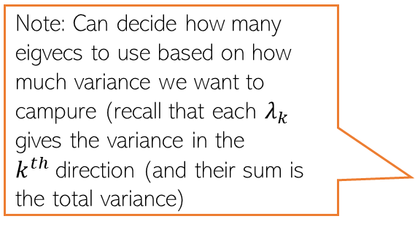
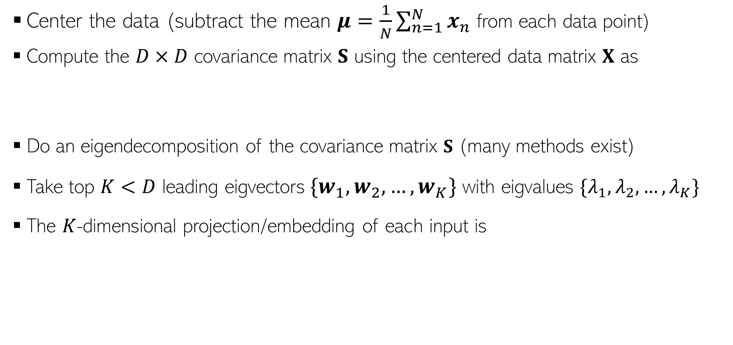

Principal Component Analysis
Center the data (subtract the mean $μ=\frac{1}{N}\sum_{n=1}^{N}{x_{n}}$ from each data point)
Compute the $D×D$ covariance matrix $S$ using the centered data matrix $X$ as
Do an eigendecomposition of the covariance matrix $S$ (many methods exist)
Take top $K<D$ leading eigvectors${\{w}_{1},w_{2},…, w_{K}\}$ with eigvalues $\{λ_{1},λ_{2},…, λ_{K}\}$
The $K$-dimensional projection/embedding of each input is
$$S= \frac{1}{N}X^{⊤}X$$
(Assuming $X$ is arranged as $N×D$)
Note: Can decide how many eigvecs to use based on how much variance we want to campure (recall that each $λ_{k}$ gives the variance in the $k^{th}$direction (and their sum is the total variance)
$$z_{n}≈ W_{K}^{⊤}x_{n}$$
$W_{K}=\left[w_{1},w_{2},…, w_{K}\right]$ is the “projection matrix” of size $D×K$

Slide 12
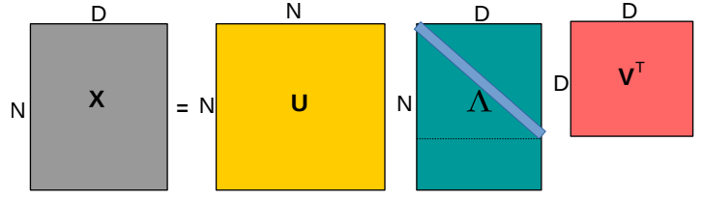

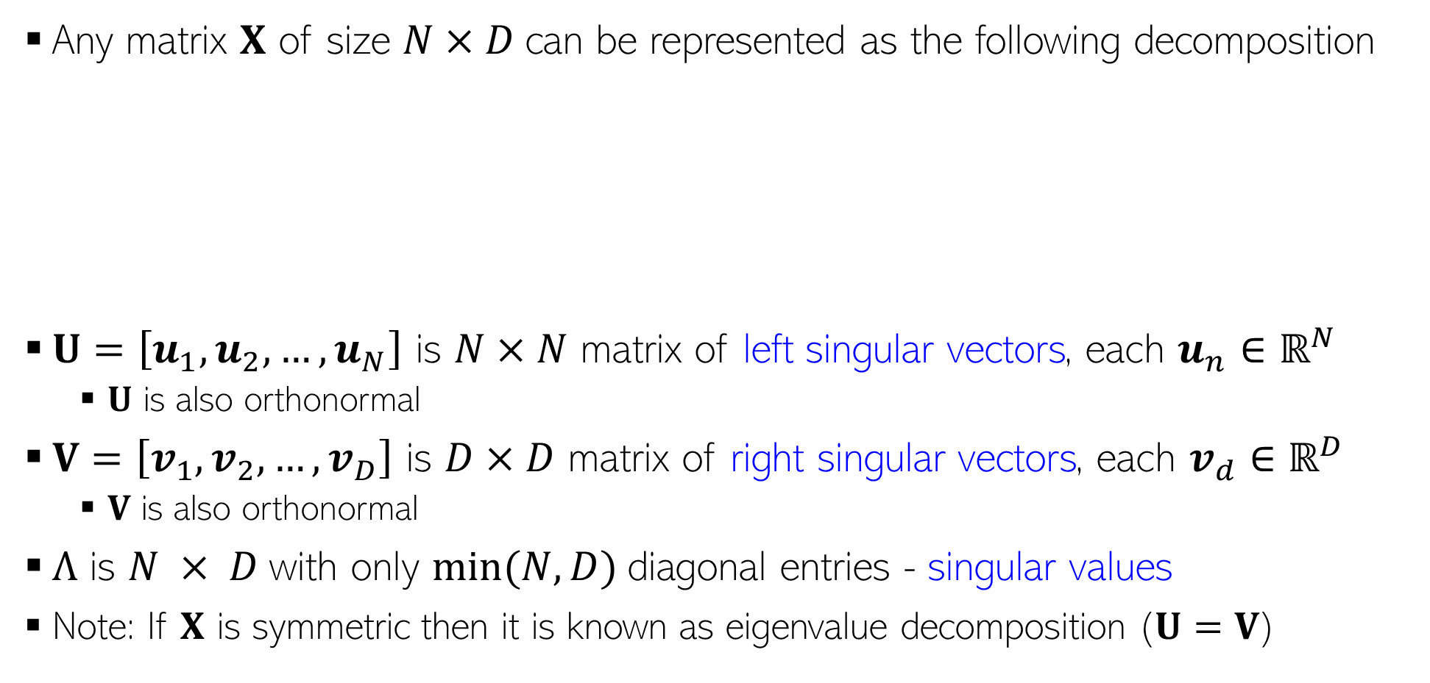
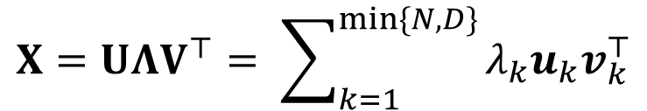
Singular Value Decomposition (SVD)
Any matrix $X$ of size $N×D$can be represented as the following decomposition
$U=\left[u_{1},u_{2},…, u_{N}\right]$ is $N×N$ matrix of left singular vectors, each $u_{n}∈ℝ^{N}$
$U$ is also orthonormal
$V=\left[v_{1},v_{2},…, v_{D}\right]$ is $D×D$ matrix of right singular vectors, each $v_{d}∈ℝ^{D}$
$V$ is also orthonormal
$Λ$ is $N × D$with only $min⁡(N, D)$diagonal entries - singular values
Note: If $X$ is symmetric then it is known as eigenvalue decomposition ($U=V$)
$$X=UΛV^{⊤}= \sum_{k=1}^{min\{N,D\}}{λ_{k}u_{k}v_{k}^{⊤}}$$
Diagonal matrix. If $N>D$, last N$−D$ rows are all zeros; if $D>N$, last $D−N$ columns are all zeros
The eigenvectors of X^{T}X make up the columns of V , the eigenvectors of XX^{T} make up the columns of U. Singular values in $Λ$ are square roots of eigenvalues from XX^{T} or X^{T}X. Singular values are the diagonal entries of the $Λ$ matrix and are arranged in descending order.

Slide 13
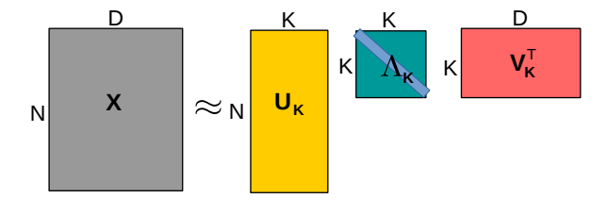
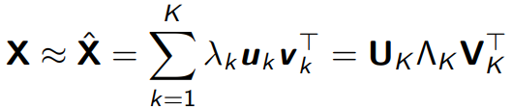
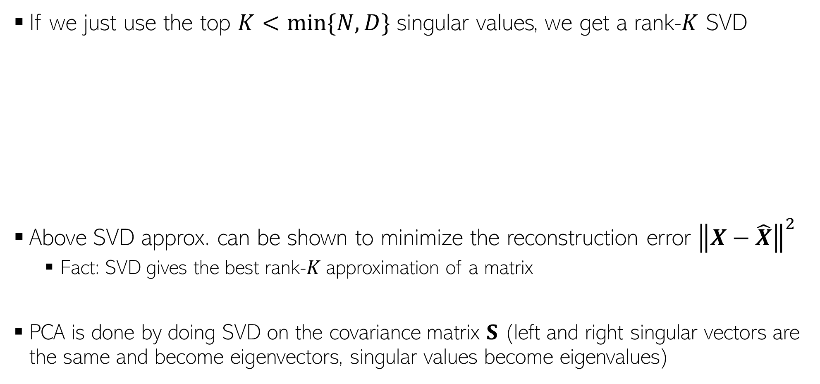
Low-Rank Approximation via SVD
If we just use the top $K<min\{N,D\}$ singular values, we get a rank-$K$ SVD
Above SVD approx. can be shown to minimize the reconstruction error ${\left\|X−\hat{X}\right\|}^{2}$
Fact: SVD gives the best rank-$K$ approximation of a matrix
PCA is done by doing SVD on the covariance matrix $S$ (left and right singular vectors are the same and become eigenvectors, singular values become eigenvalues)

Slide 14
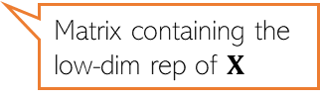

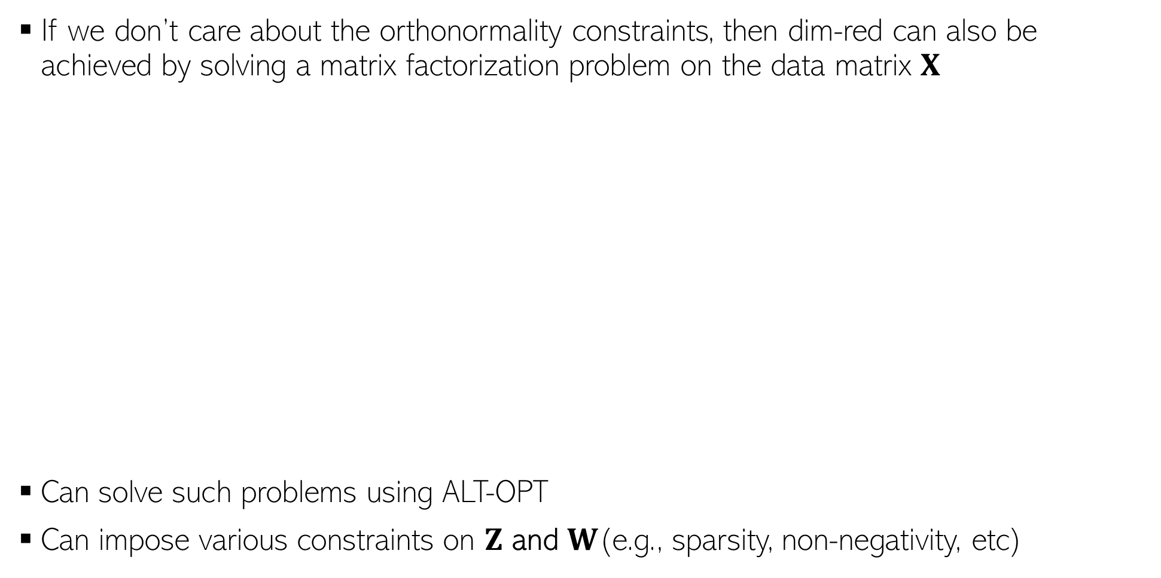
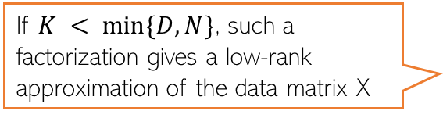
Dim-Red as Matrix Factorization
If we don’t care about the orthonormality constraints, then dim-red can also be achieved by solving a matrix factorization problem on the data matrix $X$
Can solve such problems using ALT-OPT
Can impose various constraints on $Z$ and $W$(e.g., sparsity, non-negativity, etc)
D
K
D
X
Z
W
K
N
$$≈$$
N
Matrix containing the low-dim rep of $X$
$$\left\{\hat{Z},\hat{W}\right\}= {argmin}_{Z,W}{\left\|X −ZW\right\|}^{2}$$
If $K < min⁡\{D,N\}$, such a factorization gives a low-rank approximation of the data matrix X
Notes:
Low Rank Approximation => LoRA uses the same for reducing the storage of weight parameters

Slide 15



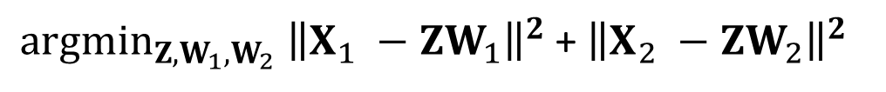



Joint Dim-Red
Often we have two or more data sources with 1-1 correspondence between inputs
Sometimes, we may want to perform a common dim-red for both sources to get a common feature rep which captures properties of both sources (or fused their info)
This can be done by doing a joint dim-red of both sources. Many methods exists, e.g.,
Canonical Correlational Analysis (CCA): looks at cross-covar rather than variances
Joint Matrix Factorization
N videos
Audio of these N videos
$$D_{1}$$
$$D_{2}$$
$$X_{1}$$
$$X_{2}$$
$$N$$
$$N$$
${argmin}_{Z,W_{1},W_{2}} {\left\|X_{1} −ZW_{1}\right\|}^{2}$ + ${\left\|X_{2} −ZW_{2}\right\|}^{2}$

Slide 16
Supervised Dimensionality Reduction
Maximum variance directions may not be aligned with class separation directions
Be careful when using PCA for supervised learning problems
A better option would be to project such that
Points within the same class are close (low intra-class variance)
Points from different classes are well separated (the class means are far apart)
Direction that preserves class separation
Projecting along this will give a one dimensional embedding of each point with both classes overlapping with each other
Projecting along this will give a one dimensional embedding of each point with both classes still having a good separation
Max variance direction (given by PCA)

Slide 17
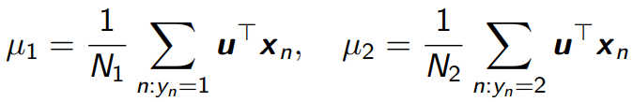


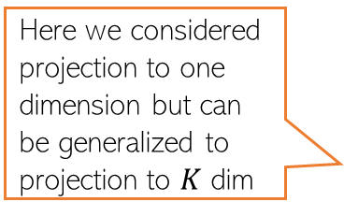
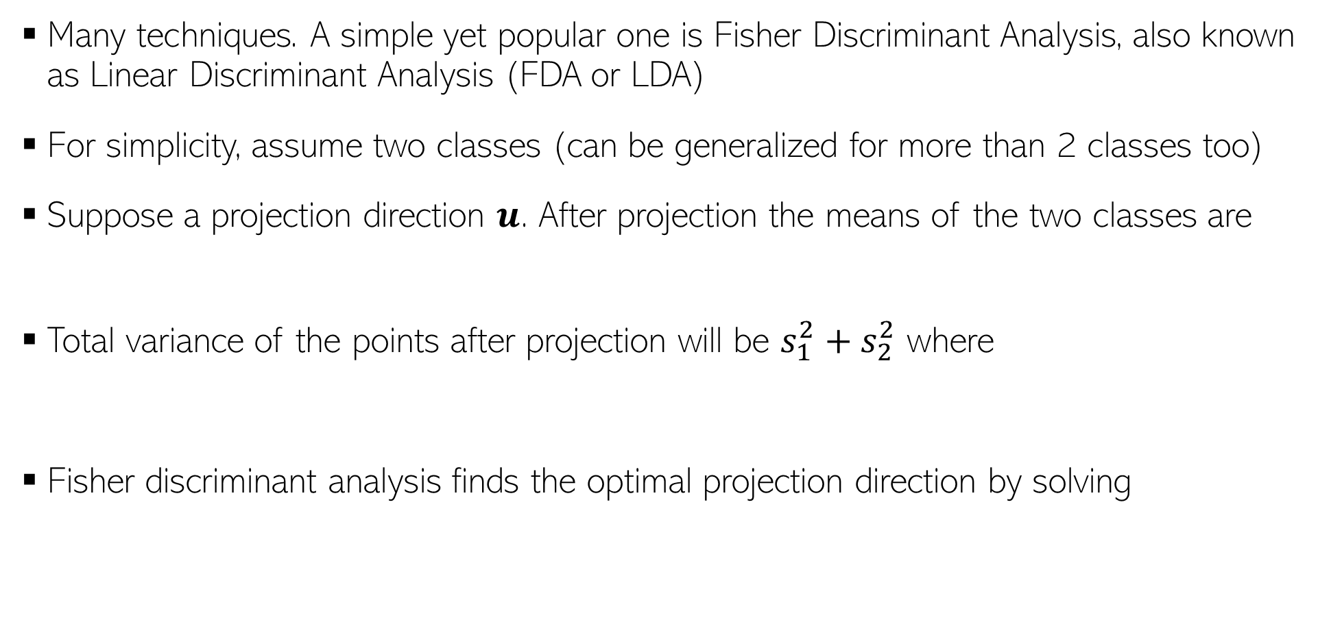
Supervised Dimensionality Reduction
Many techniques. A simple yet popular one is Fisher Discriminant Analysis, also known as Linear Discriminant Analysis (FDA or LDA)
For simplicity, assume two classes (can be generalized for more than 2 classes too)
Suppose a projection direction $u$. After projection the means of the two classes are
Total variance of the points after projection will be $s_{1}^{2}+s_{2}^{2}$ where
Fisher discriminant analysis finds the optimal projection direction by solving
This LDA should not be confused with another very popular ML technique for finding topics in text data (Latent Dirichlet Allocation)
Here we considered projection to one dimension but can be generalized to projection to $K$ dim
The solution to this problem involves solving an eigendecomposition problem that involves within class covariance matrices and between class covariance matrices
Push the means far apart
Make each class tightly packed after projection (small variance)

Slide 18
Nonlinear Dimensionality Reduction

Slide 19
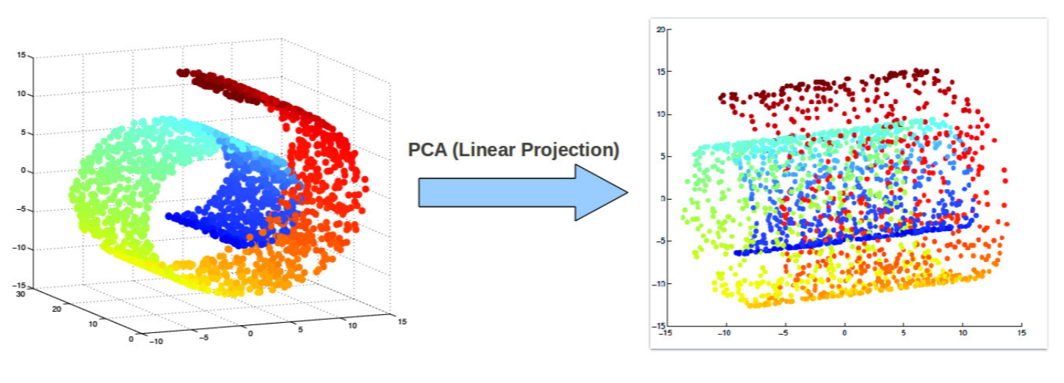
Beyond Linear Projections
Consider the swiss-roll dataset (points lying close to a manifold)
Linear projection methods (e.g., PCA) can’t capture intrinsic nonlinearities
Maximum variance directions may not be the most interesting ones
Relative positions of points destroyed after the projection

Slide 20
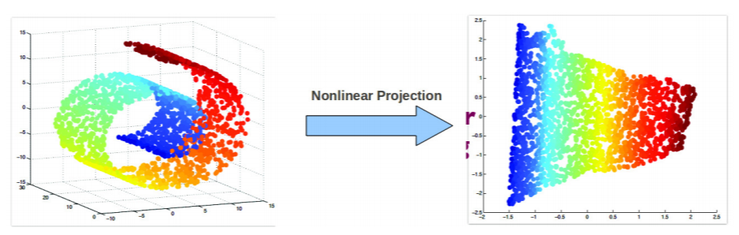
Nonlinear Dimensionality Reduction
We want to a learn nonlinear low-dim projection
Some ways of doing this
Nonlinearize a linear dimensionality reduction method. E.g.:
Cluster data and apply linear PCA within each cluster (mixture of PCA)
Kernel PCA (nonlinear PCA)
Using manifold based methods that intrinsically preserve nonlinear geometry, e.g.,
Locally Linear Embedding (LLE), Isomap
Maximum Variance Unfolding
Laplacian Eigenmap, and others such as SNE/tSNE, etc.
.. or use unsupervised deep learning techniques (ex: autoencoders)
Relative positions of points preserved after the projection

